Slide 1
5-minute survey for anyone who works or volunteers with children and families
Do you work or volunteer with children and families?
The Herefordshire Safeguarding Children Partnership would be very grateful if you could take 5-10 minutes to complete this survey, so we can better understand how practitioners are accessing and using resources and guidance.
Please follow this link to share your experiences:
Herefordshire Practitioner Survey 2024
Please share within your teams. Survey will close in 2 weeks – Friday 3 May 2024

Slide 2
Updates - New courses and training opportunities
Mental Capacity Act and DOLS
Trauma-Informed Practice Training
Understanding Child Neglect
Level 2 and Level 3 Child Safeguarding (Paused)
www.herefordshirecpd.co.uk

Slide 3
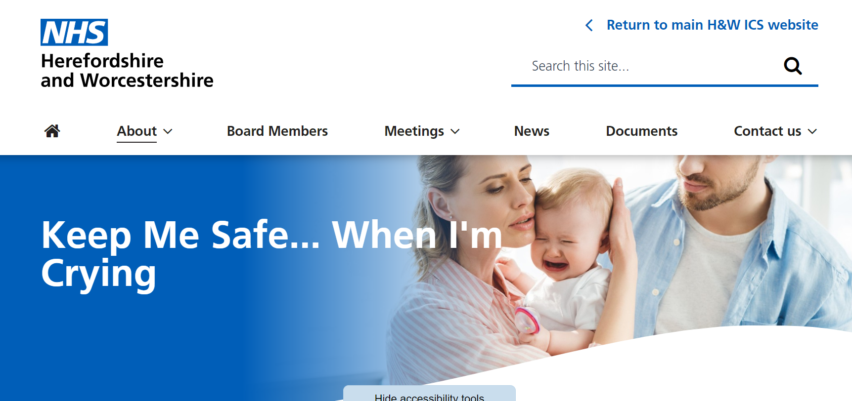
Keep Me Safe… When I am Crying
For anyone who works/volunteers with infants and new parents.
To support those who meet families with babies of a very young age where crying may be reported as a worry or concern by the parent or carer.
Launch Webinars:
Mon 13 May, 13.00–14.00
Thurs 16 May 16.00 – 17.00
Tues 21 May, 12.00–13.00
Keep Me Safe…When I’m Crying Guidance and Resources:
Keep Me Safe... When I'm Crying :: Herefordshire and Worcestershire Integrated Care System (icb.nhs.uk)

Slide 4
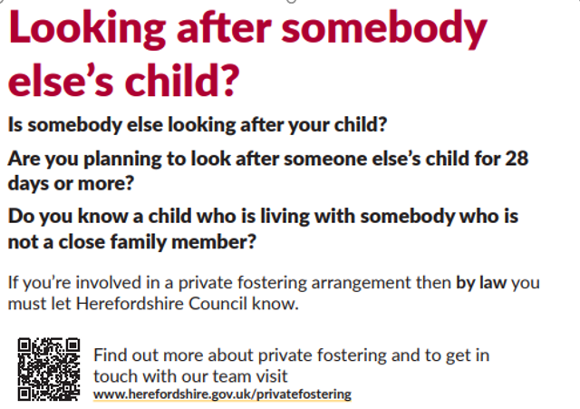
Reminder… Private Fostering

Slide 5
Thank you for joining – we hope you enjoyed the event Please complete the evaluation – link in chat Visit our website at www.herefordshiresafeguardingboards.org.uk Safeguarding courses: www.herefordshirecpd.co.uk Don’t forget to sign up for the fortnightly Partnership bulletin for the latest news and events Any questions about this event or the work of the partnerships and board: admin.sbu@herefordshire.gov.uk Thank you!

