Slide 1



Recognising and Responding to Child Sexual Abuse
Vicki Wynn, Senior Practitioner
The only UK-wide charity dedicated solely to tackling child sexual abuse

Slide 2
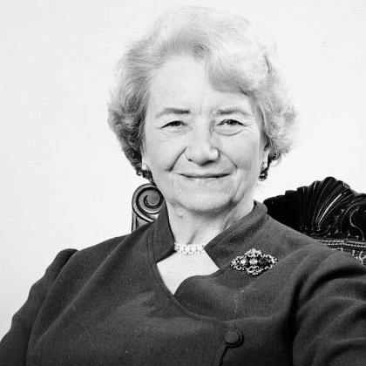
Our founder
The ‘Mother to Hundreds’
Baroness Lucy Faithfull was
a pioneer of child protection.
As the first social worker to be appointed to the House of Lords, she campaigned tirelessly for the powerless and voiceless.
Her influence can be found in legislation ranging from children’s welfare to the criminal justice system.
Lucy was ahead of her time,
not least in recognising that
if we are to protect children from sexual abuse we must
work with sexual offenders,
a view that still challenges today’s society.
She established The Lucy Faithfull Foundation when she was in her eighties – a charity committed to preventing child sexual abuse.
WORKING TO PROTECT CHILDREN
2
THE LUCY FAITHFULL FOUNDATION |

Slide 3

The Lucy Faithfull Foundation offers...
Assessments of adults, young people and children alleged, suspected or convicted of engaging in harmful sexual behaviour
Psychological assessments
Assessments of adult family members capacity to protect
Stop It Now! Helpline and associated online resources
Shore website for young people
Parent Protect website
Circles of Support and Accountability
Training & consultancy for professionals
Individual and group interventions – Inform Plus, Engage Plus, Inform and Inform YP, Protective Parenting, Addressing Offending Behaviour
Notes:
Stop It Now! - The helpline was launched in 2002.
Small team of 30 advisors who:
Answer calls on our Stop It Now! helpline
Respond on our online chat service
Reply to secure anonymous emails (anonymisers)
bespoke interventions with, for example, those who have committed contact sexual offences.

Slide 4

Content we will cover today
The scope of the problem
Recognising signs child sexual abuse
Considerations when assessing persons posing a risk of sexual harm to children, and protective capacity of parents/carers
Assessing risk in the absence of a conviction
The Faithfull Classification System
Resources for working with families

Slide 5
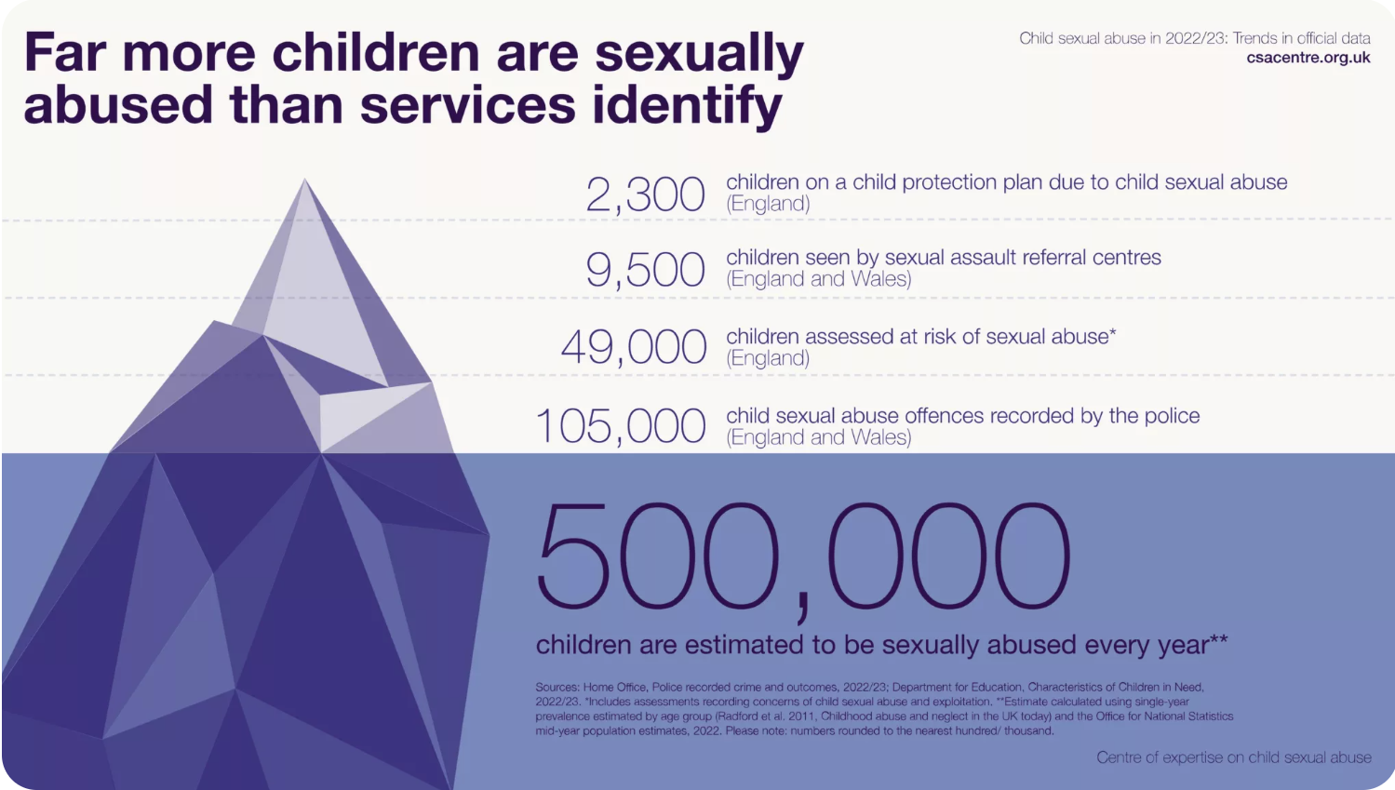

Slide 6
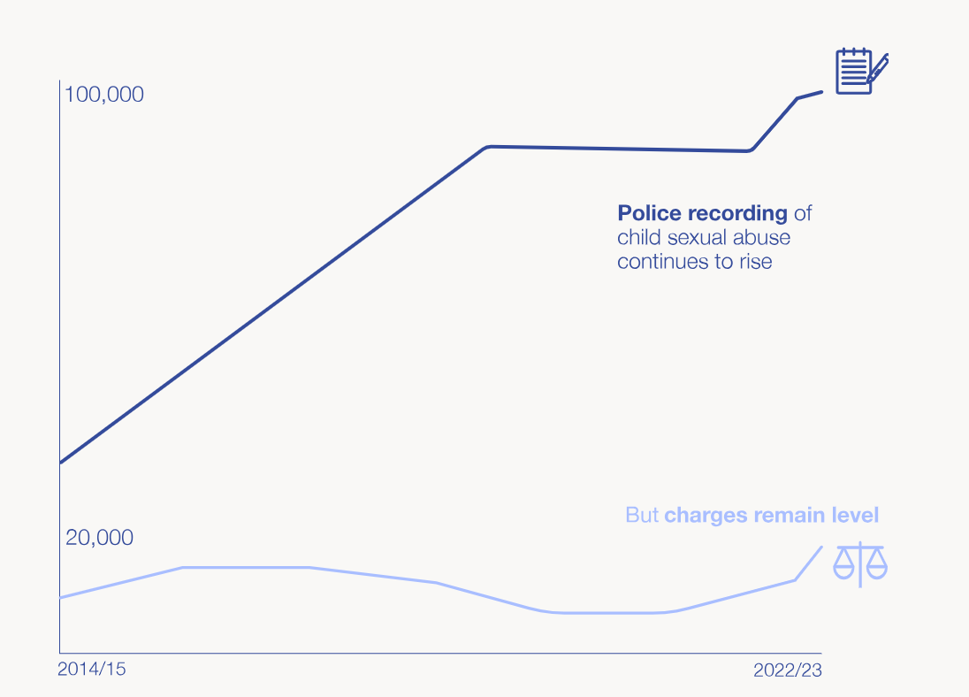

Slide 7
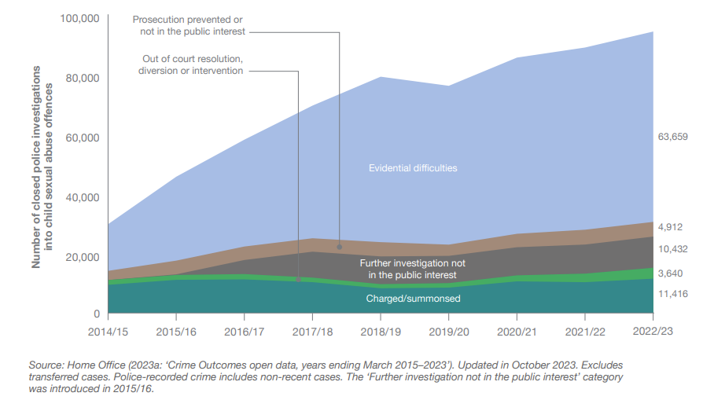
Crime outcomes for child sexual abuse offences in England and Wales, 2014/15–2022/23

Slide 8

Recognising Risk

Slide 9
Warning Signs in Adults
Tucking a child into bed without being asked
Inappropriate touch, e.g. kissing on lips, tickling
Assuming role of sex educator
Inappropriate dress
Isolating a child
Over interest in a child’s social behaviour or sexual development
Inappropriate response to a child’s behaviour, e.g. child seeking affection
Buying non age-appropriate clothing for a child
Favouritism
Rigid authoritarian or unassertive patterns of discipline
Undue interest in a child’s hygiene
Initiating prolonged physical contact
Shift in parental responsibility
Increase in family isolation
Poor privacy boundaries

Slide 10
Warning Signs in Adults – General Behaviour
Unresolved marital conflicts; refusing to discuss problems
Unassertive or aggressive manner
Anxious, depressed, unable to complete tasks
Loss of control over other behaviour, e.g. drinking, smoking, drug taking, gambling
Change in sexual behaviour
Use of pornography; excessive use of internet – watching what?
Sexual preoccupation
Difficulty accounting for time
Over confident about not reoffending
Avoiding appointments with professionals
Involvement in youth work; wanting to spend too much time with young people
Work related stress
Rapid religious conversion
Last to bed, up during the night, last to get up in the morning

Slide 11
Warning Signs in Children
· Clinging behaviour
· Bedwetting
· Sleep disturbance (poor sleep pattern, nightmares)
· Eating problems (loss of appetite, unusual fussiness, over-eating)
· Sudden mood changes
· Withdrawn, apathetic
· Social isolation
· Aggression, temper tantrums
· Running away
· School problems (poor performance, truancy)
· Suicide attempts
· Self harm
· Drug/alcohol use/dependency
· Sexually inappropriate behaviour
· Being out of control
· Unusual fears
· Psychosomatic illness
· Cruelty to other children or animals
· General unhappiness
· No obvious signs at all (sometimes this is delayed as children cover up abuse)

Slide 12
Assessing Risk

Slide 13

Purpose of Assessment
Assessing the risk of sexual harm a person poses:
the person’s current attitude to and view of the abuse;
the insight they have;
what the nature of the risk is;
Whether there are risks to a particular child/children;
whether the gender of the child is important;
whether any contact should be supervised or not;
whether the person should/could undertake any form of therapeutic work to manage risks posed.
Assessing protective capacity of parents/carers:
the person’s knowledge and understanding of the harmful sexual behaviour/allegations;
their general understanding of sexual abuse;
their ability to prioritise their child(ren)’s needs;
the nature of the relationship with the person posing a risk;
the person’s ability to work openly/honestly with professionals;
whether the person should/could undertake therapeutic or educative work to build their protective capacity.

Slide 14
The fundamental issue:
Research suggests many people convicted of sexual offences return to live with their partners and children, or state a wish to do so
It also suggests many others move into new family situations.
(Fisher & Beech 1998 on Owen & Steele 1991; Beech, Fisher & Beckett 1998; Maletzky & Steinhauser 1998; Eccles & Walker 1998)

Slide 15
And…
While children want or need their abuse to stop, many want to remain in touch with the person who has abused them, if s/he is a loved one
Removing one risk (the person who may (re)abuse them) may increase other risks (emotional impact of lack of contact with parent/s, break up of family)
There are often no good options, just least bad…

Slide 16
Static risk factors
Young age
Volume of sexual offending
General criminality/violence
‘Hands off’ sexual offences
Male prepubescent victims
Unrelated or stranger victims
Lack of adult sexual relationship

Slide 17
Dynamic risk factors (1)
Sexual interests:
Sexual preoccupation
Sexual interest in children
Sexual preference for sexualised violence and/or rape
Sexual preference for unusual sexual practices, if linked to abusive behaviour

Slide 18
Dynamic risk factors (2)
Anti-social orientation:
Hostile, resentful attitudes
Pro-abuse sexual attitudes
History of rule violation
History of reckless, impulsive behaviour
Personality disorder
Lifestyle instability
Employment instability
Alcohol / substance misuse
Emotional identification with children
Conflict with intimate partners
Poor self-regulation e.g. managing emotions; solving problems
Treatment drop-out

Slide 19

Faithfull Classification Scheme
Faithfull Classification Scheme
Devised by David Thornton and LFF in partnership
Uses only stats about intrafamilial sexual offending
Suitable for situations where there are no known convictions; current allegations; or merely concerns or substantial suspicions
WORKING TO PROTECT CHILDREN
19
THE LUCY FAITHFULL FOUNDATION |

Slide 20
FACS
Offers a way of correlating known information about a person
A way of clarifying thinking and concerns
A way of crystallizing arguments and avoiding prejudice
Helps us to make defensible decisions
Can be referred to as ‘based on research by D Thornton’
WORKING TO PROTECT CHILDREN
20
THE LUCY FAITHFULL FOUNDATION |
Notes:
The stats that we currently use are:
Child sexual abuse is a major public health problem affecting more than a million children under the age of 16 in the UK- see other stats below
1 in 6 children are sexually abused before they are 16 in England and Wales
One third of child sexual abuse is committed by under 18s
90% of children who are sexually abused know their abuser
1 in 3 who have been sexually abused never tell
This is used a lot:
7.5% of adults are estimated to have experienced sexual abuse before they were 16 – approximately 3.5% men and 11.5% women – according to the latest prevalence survey by the ONS. This represents an estimated 3.1 million people having experience child sexual abuse in England and Wales – 700,000 men and 2.4 million women. Looking more widely at a number of different surveys that ask children and adults about their experiences of child sexual abuse, the CSA Centre suggests the prevalence could be higher. The CSA Centre estimates that, at a minimum, 15% of girls and 5% of boys experience some form of child sexual abuse.

Slide 21

Overview of FACS
Part A – Indications of risk of trying to commit offences against same or new victims
Part B – Factors indicating power to create the opportunity to abuse
Part C – Child vulnerability factors
Part D – Indications of possible reduction in risk following participation in sex offender treatment
WORKING TO PROTECT CHILDREN
21
THE LUCY FAITHFULL FOUNDATION |

Slide 22
FACS Part A: Risk Indicators
1: 3 + victims? (age under 16)
2: Any extra-familial victims?
3: Young (18 to 25)? This is the age he will be when he next has the opportunity to offend
4: Criminal (non-sexual offences)?
5. Lack of enduring adult relationship? 2 years or more with an adult
6. Violent (convictable) - Are there allegations of non-sexual assaults sufficiently severe they could result in a criminal conviction for violence?
7. Distortions - does the offender express beliefs of the kind that might be used to “give permission” for the sexual abuse of children?
8. Impulsiveness - repeated poor problem-solving; repeatedly acting without thinking; lifestyle that is disorganised and chaotic, general tendency to make irresponsible choices
9. Sexual Preference - Is there evidence of a sexual interest in children below the age of 13?

Slide 23
FACS Part B: Power to Create an Opportunity to Abuse
Domestic violence
Has he repeatedly used physical violence or threats of violence against partners/adult family members he was living with?
Manipulativeness
Does he show evidence of repeated manipulative behaviour, in addition to any manipulation that may have been involved in the harmful sexual behaviour?
Domineering/sexist behaviour in relationships
Is there evidence of sexist attitudes in his relationships or of domineering behaviour in relation to any partner he was living with?

Slide 24
FACS Part C: Child Vulnerability Factors
Victim gender: Is there an allegation of offending by this man against another child of the same gender as the child at risk?
Prior victim: Is this man alleged to have previously offended against this child?
Prior abuse: Has this child been subject to previous sexual abuse or reportable physical abuse or neglect (from any source)?
Disability: Is there any form of disability that could increase the child’s vulnerability and the means of an offender having access to the child?
Absence of powerful adult protector: A powerful adult protector is someone who is:
a) prepared to accept that the alleged perpetrator poses a potential risk;
b) is committed to ensuring the child’s safety even at the expense of the perpetrator;
c) is in a position to act as a protector (e.g. by being the primary caregiver for the child);
d) has the personal attitudes and skills required to resist intimidation or manipulation from the alleged perpetrator;
e) is not strongly economically, emotionally, or practically dependent on the alleged offender.
Score this factor as applying if any child to whom the alleged offender has easy access lacks a powerful adult protector.
6. Absence of a child protection plan: Score this factor as applying if no child protection plan has been implemented for the child being considered.

Slide 25
FACS Part D: Reductions in Risk Following Treatment
Effective method: Did the treatment intervention use Cognitive-Behavioural methods? (Cognitive-Behavioural methods have been found to be effective in reducing risk with a broad range of offenders, including sex offenders. At present there is no similar evidence for the effectiveness of other methods).
Duration: Did the offender complete at least 70 hours of treatment? Treatment of shorter duration is unlikely to be effective in reducing risk. If the offender has a wide range of problems underlying their offending, much longer, possibly residential, treatment may be required.
Content: Did the areas addressed by the treatment intervention include: a) taking responsibility for abusive behaviour; b) beliefs used to “give permission to offend” (cognitive distortions); c) awareness of the harm done to others; d) domineering or sexist behaviour; e) development of relapse prevention skills?
Co-operation: Did the alleged offender actively co-operate with and participate in the treatment intervention (as opposed to missing sessions; attending but not actively participating; or failing to complete “homework” exercises)?
Completion of treatment tasks: Do the treatment-providers assess the alleged offender as a) taking responsibility for his abusive behaviour; b) ceasing to justify his abusive behaviour; d) ceasing to blame the victim or other people for it; e) having developed a relapse prevention plan?
Co-operation with child protection plan: Is the alleged offender prepared to actively co-operate with a protection plan formulated in relation to children to whom he might have easy access?

Slide 26
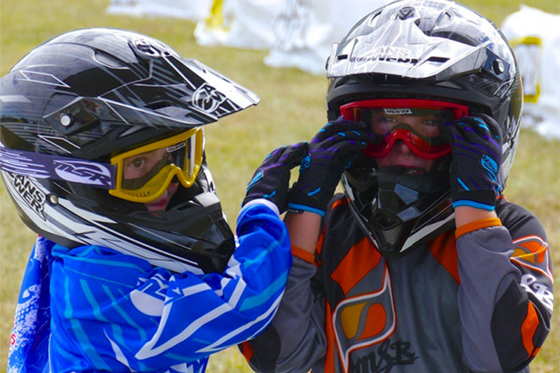
Protective factors
Lower the risk of reoffending
Not just internal, psychological features
External, environmental and circumstantial features of an individual’s life too
Some are static e.g., secure attachment in childhood
Some are dynamic e.g., living situation
They are the opposite of a risk factor – not the absence of a risk factor

Slide 27
Protective factors for sexual offending
Pro-social network
Intimate stable relationship
Meaningful activity and positive routine e.g. employment and hobbies
Social investment e.g. giving something back
Family and community ties; feeling valued by others
Feelings of hope and self-efficacy e.g. ‘I can rebuild my life’

Slide 28
Understanding Denial
There is a common misconception regarding denial and the risk of re-offending
Current research does not show a correlation between a person’s denial of sexual offending and an increased risk of sexual re-offending
Denial is a normative response to stress
Denial makes it more difficult to explore and understand a person’s motives, the context of the abuse, and the factors that contributed to the onset of offending

Slide 29
Continuum of Denial Taylor (1996)
denial
nothing happened
something happened, but it wasn’t me
something happened but they wanted to
something happened but not as bad as they said
it happened, but at the time I didn’t know it was wrong
it happened but it was an accident
it happened, I don’t know what came over me
it happened, but it wasn’t planned
it happened, but it never happened before
it happened, I planned it and I know it hurt people so it won’t happen again
it happened, it hurt people, I understand my thinking. I think about it still, but this is my relapse prevention if I feel tempted again
responsibility
Notes:
Ask – is it possible to work with someone productively who denies their offending? How?
How did you find yourself in this position?
Hypotheticals
What would you like to change about your life?
Good lives

Slide 30
Journey toward realisation of risk?
Disbelief, denial, minimisation
Natural protection of family
Shock, fear, anger
Projection of blame onto authorities
Self-blame/shame
Pain of realising and experiencing consequences
Readjusting view of abuser, self and world
Notes:
Ideally this should be the journey that you see an NOP go on
So as we can see the impact on an NOP is massive and everyone responds in different ways and will be impacted in different ways
Annie Stubley suggests that anything mum says in the first 24-48 hours – or even the first week should maybe not be recorded but should definitely not be brought up six months later if this journey can be seen.

Slide 31
Poor Prognosis for Protectively Parenting
A number of factors are also known to be linked with a poorer prognosis in relation to a parent’s ability to protectively parent. These factors include:
mother having a history of severe physical or sexual abuse
her relationship with her own mother being characterised by extreme rejection and emotional deprivation
having a repetitive pattern of abusive adult relationships
any prior concerns of neglect and abuse of her own children
marked mental health difficulties including personality disorder and substance misuse
Craissati, J (2004). Managing High Risk Sex Offenders in the Community: A Psychological Approach. Hove: Brunner-Routledge
Notes:
Ideally this should be the journey that you see an NOP go on
So as we can see the impact on an NOP is massive and everyone responds in different ways and will be impacted in different ways
Annie Stubley suggests that anything mum says in the first 24-48 hours – or even the first week should maybe not be recorded but should definitely not be brought up six months later if this journey can be seen.

Slide 32
Engagement – top tips
Consider barriers – learning needs, age and developmental issues, language, cultural considerations, gender.
Do we need to adapt our style and material to suit their needs?
Ask what they need – offer breaks, adaptions, be flexible where possible.
Think about the environment in which you are seeing the client – distractions, suitability – do they/you feel safe and able to talk?
Influence of others on their views and opinions? Are you seeing them alone or with a partner?
Your role – conflict of interest?
Managing distress, anger, hostility – we need to model calmness and allow space for feelings.
Notes:
If it is taboo she might find it difficult to hear and process some of our concerns, but it doesn’t automatically mean she cannot protect

Slide 33
Engagement – top tips
Socratic questioning is about eliciting information from people through open questions. What, When, Where, How, Why . .
Rather than giving people answers, it’s about them learning things for themselves, rather than it being imposed upon them.
Reflection – active listening – clarifying questions, summarising key points.
Style – we need to be genuine, open, transparent and look interested. Our body language, our approach really does make a difference.
We need to demonstrate empathy, be gently challenging, roll with resistance, raise doubt, be inquisitive, warm, and non-confrontational.
Modelling - people learn much of their behaviour through witnessing others – we can be friendly but assertive, take responsibility for our own actions, model good rapport and communication.
Praise where it is due – highlight positives and give balanced feedback – this is motivational.
Notes:
If it is taboo she might find it difficult to hear and process some of our concerns, but it doesn’t automatically mean she cannot protect

Slide 34
Thoughts to consider in your assessment – person posing a risk of sexual harm
Details of offences, suspected offences – against children? Adults?
Time elapsed since last offence – has it been more than 10 years? (think about the recidivism research)
Life circumstances at the time of the offending (relationship status, drugs/alcohol, employment, mental health, lifestyle)
Any other offences? E.g., domestic violence, assault, battery
Adverse childhood experiences? Experiences of parents? How has this shaped their world view or relationships?
How did they learn about sex and relationships? What views do they have on the age of consent, consensual sex, do they have any specific preferences, fantasies?
Any religious or cultural influences over their relationship or life choices?
Links with other families
What is their opinion of the child who has made an allegation? Or children in the images?
What information have they told their partner? Is this accurate?
When observed with their children – is there emotional warmth, responsiveness, secure attachment, affection, ability to meet the children’s emotional and care needs?
What is their view of why they offended?

Slide 35
Thoughts for your assessment - protective carers
Relationship to the person posing a risk – are they dependent for finances, accommodation, immigration status, any evidence of grooming?
Are they reluctant to share concerns due to fear of repercussions?
Any issues around bringing shame on the family?
Links to other concerning adults
Understanding of sexual abuse/exploitation/online offending
Thoughts on sex, relationships, is it taboo?
Attitudes and beliefs
Understanding of Social Care concerns – understanding, denial, minimisation
What info do they have about the offending / allegations? Is it accurate?
Reactions – who is responsible, do they think loved one is capable of abusing children, do they accept they ‘might have’
Understanding of impact of abuse
Opinion of what it was about those children that led to them being vulnerable to abuse
Recognising the needs of the children and ability to meet them, including while separated from person of concern
Quality of relationship with child, perception of the child
Ability to recognise signs of abuse/exploitation and act appropriately
Notes:
If it is taboo she might find it difficult to hear and process some of our concerns, but it doesn’t automatically mean she cannot protect

Slide 36
Working with Families

Slide 37
Supporting families to prevent abuse
Use of family safety plans, applicable to the whole family
Give children age appropriate knowledge (www.shorespace.org.uk)
Education for parents (www.parentsprotect.co.uk)
Support for persons posing a risk of sexual harm to children (www.stopitnow.org.uk)

Slide 38

Child sexual abuse is preventable, not inevitable.
Thank you for your attention
Emma King
Head of Clinical Services (Adults)
eking@lucyfaithfull.org.uk
Vicki Wynn
Senior Practitioner Assessments and Interventions (Adults)
vwynn@lucyfaithfull.org.uk

