Slide 1
Early Help Service
Herefordshire
(Early Help)

Slide 2
Have you ever worked with any Early Help services before?

Slide 3
Right Help, Right Time - Early Help
Early Help is everyone’s responsibility.
Supporting the whole family at an early stage to prevent them requiring more specialist services or social care intervention.
Early Help Service Directory

Slide 4
Early Help – Local Authority Teams
Early Help, Herefordshire council is made up of the following teams:
1. CHAT (Children’s help & Advice Team)
2. Early Help Coordinator
3. Early Help Family Support
4. Children Centre Services
5. Supporting Families
6. Advanced Practitioners

Slide 5
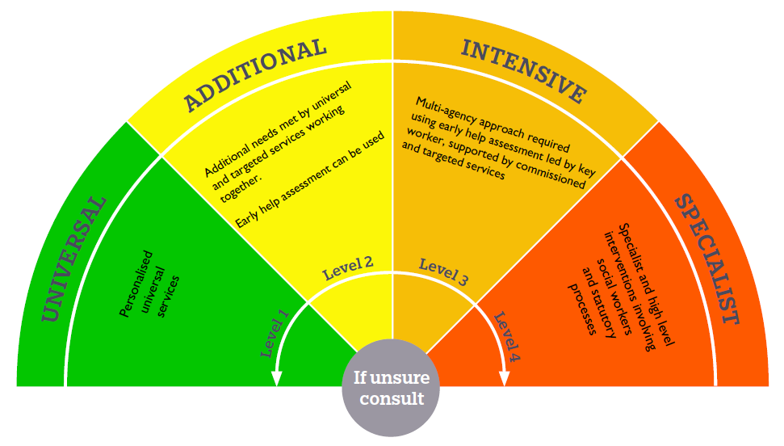
CHAT (Children’s Help & Advice Team
The CHAT Team (formerly Early Help Hub) sit alongside the Multiagency Safeguarding Hub and will be responsible for contacts which come into the local authority at level 3 or below, and for contacts that MASH have assessed as not needing level 4 intervention.
The CHAT offers the following help to families:
Signposting
Advice and guidance
Assessing need
Referrals to other services
Advising on Next Steps,
including recommending an early help assessment.
CHAT helpline:
01432 260261

Slide 6
Early help Co-Ordinator
Complete early help assessments (EHAs) with families
Process EHA’s and send referrals to appropriate agencies (including step down EHAs from social care)
Give advice and guidance to families and professionals about support services
Track progress of EHA’s and close them when support has been completed
Support professionals to complete EHAs
Follow up on cases screened at level 3 via the CHAT team
Early
Help
Co-ordinator Team
Notes:
All Early help assessments are uploaded to mosaic and an Early help step is created in the workflow.
EHC’s keep a registry of all children open to early help. This is used for data and Ofsted reporting.
EHCs also provide information regarding early help to MASH to support decision making

Slide 7
The Early Help assessment
Early help is non-statutory so consent must be obtained to proceed.
The early help assessment (EHA) can be completed via the Portal by any professional that is in contact with a family.
The EHA is aligned with the Supporting Families outcomes and the action plan is designed to enable SMART outcomes against these requirements.
There is step down version which is completed with an Advanced Practitoner and Social worker to complete when a family is being stepped down to early help.
Team around Family meetings – 6 weekly.
Notes:
* Family First outcomes - refer to further slide on the Troubled Families Agenda
For more information on early help visit Herefordshire council website https://www.herefordshire.gov.uk/support-schools-settings/behaviour-support/2?documentId=615&categoryId=200227
Step down procedure - see separate PowerPoint or refer to website as above

Slide 8
Our Family Support Workers work holistically with all family members, in the home, in school or the community.
Early Help Family Support Team
We provide support for a multitude of issues such as:
improving parenting skills,
supporting back into work,
school attendance,
keep safe work with the children,
wishes and feelings work.
We support families to access other agencies for specific pieces of work when required. Creating a team around the family, liaising and working with all professionals involved.

Slide 9
Parenting groups
Link with schools
We deliver 5 Triple P parenting programmes across the county on a termly basis.
Standard triple P – 5-11 year old.
Teen Triple P – 11-18 year old
Stepping Stones – 5-11 years, for children with additional needs.
We have one family support workers who is linked to a school. They provide support to the school for both parents and children alongside home visits and the package of support for the whole family.

Slide 10
Young Carers Support Service
A Young carer is a child or young person aged 5 -18 who helps look after someone in their family who has a disability, illness or mental health, alcohol or drug problem.
The team are all skilled in and dedicated to completing statutory assessments for Young Carers and their families.
Young carers can self refer, or be referred by any professional with verbal consent from the family.
Our Young Carer FSW’s then assesses the families needs, delivering a tailored package of support.

Slide 11
Domestic Abuse Partnership Officer
We are fortunate to have Domestic Abuse Partnership Officer (from WMWA) within the Early Help team, 3 days a week.
The role provides specialist knowledge and understanding of domestic abuse to the team and families affected.
Assesses needs and risk for each individual/family allocated, with recognition of those issues which may require additional specialist service input.
Ensures that pathways for support in addressing issues relating to domestic abuse are seamless and accessible.

Slide 12
Domestic Abuse Partnership Officer
Provides intensive one-to-one face to face and remote (e.g. telephone and video call) advocacy and support to those experiencing domestic abuse living in their own homes or in other arrangements in the community.
Complete structured support and safety planning programme with each individual /family to deliver agreed outcomes.
Work effectively in partnership with other agencies both within the Early Help team and beyond, to ensure a cohesive package of co-ordinated support for the individual/family.

Slide 13
Early Help Family Support Case Study
Family: Mother (M) Son (A) 13 years old
What problems did family have? | What work took place? | EHFSW supported Mum by: | EHFSW supported A by:
A’s school attendance was low 89%. A was not making good progress at school. M struggled to use behaviour strategies with A, she didn’t know what to do and his behaviour was becoming more angry and violent towards M. A would like to have more things to do to keep him busy after school. There was domestic abuse in M’s relationship with A’s father, they are separated now but A saw his dad being violent and emotionally abusive towards his mum. | School contacted EH Hub to say they were worried about A as M had spoken to them to say she was struggling with his behaviour at home and him refusing to attend school. EH Hub worker spoke to M and A and asked the school to complete an EHA. School wrote the EHA with M. An Early Help FSW was allocated to work with the family. They completed the following work: FSW wrote an ‘action plan’ with M and A listing all the issues that they wanted to work on and how the FSW and other professionals can help. TAF meetings were held every 4 weeks with M, FSW and all other professionals. | Working alongside Women’s Aid to provide advice and support for M about the abuse. Looking at morning routines and planning how M could get A up and ready for school on time. Introducing Triple P Parenting strategies, to help M learn how to put boundaries into place and what to do when M’s behaviour is not acceptable. Working on a keep safe plan for A for when he was out in the community. Agencies Involved Early help Family Support Worker (FSW) School Women’s Aid – CHIDVA (Child and adolescent domestic violence advisor) Women’s Aid - Freedom programme for M Interpreter service | Referring A to the CHIDVA and the helping Hands course at Women’s Aid for further support about the DA that he has witnessed. Meeting with school to plan how school could support A to increase his attendance. Completing direct work with A (one to one) looking at why he did not want to attend school. Completing direct work with A focussed on his thoughts and feelings, talking about his emotions and the words to use to describe how he is feeling. Completing keep safe work and plans with A around what to do if Dad made threats. FSW, M and A looked at the clubs available in the area – A now attends boxing and football.

Slide 14
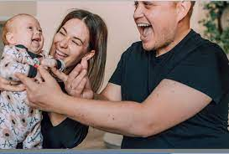
Children’s Centre Services offer in Herefordshire is open to all families who have a child who is aged 0 to 5 years.
We aspire to help parents and carers to give their children the “Best Start in Life” – The best start for life: a vision for the 1,001 critical days – www.gov.uk _________________________________________________
Children’s Centre Services work across all Levels of Need to support families to have access to the Right Help at the Right Time
Children Centres are at:
Greencroft at Marlbrook School
Ledbury
Leominster
Ross on Wye
Widemarsh
Herefordshire Children's Centres Facebook Page

Slide 15
Children Centre Targeted support
Targeted support is provided through an Early Help Assessment, via the step-down process or as part of CIN or CP plan.
All families have a team around them (TAF) and regular 6 weekly reviews are convened, TAF meetings, liaising and working with all professionals involved.
Direct work includes: Evidence Based Programmes include:
Child Development
Routines and Boundaries
Early Relationships/Bonding
Speech and language activities
Domestic abuse support
THIS LIST IS NOT EXHAUSTIVE!
Let’s Talk with your Baby
Elklan
Baby Massage
Bookstart
Triple P Transitions
Solihull Approach Parenting groups
CCS deliver parenting courses in small groups across the county termly.
The course is facilitated by two practitioners over 8-10 weekly sessions.
The Solihull Approach assists parents to reflect on their child’s behaviour and their relationship with their child.

Slide 16
First Steps Programme
First Steps is an enhanced offer for new parents to be 21yrs and under which aims to offer support that improves outcomes for parents and baby and reduce the requirement for additional specialist services.
We are able to extend the offer for parents to be who are up
to age 25 if they are care leavers.
The First Steps offer includes:
An allocated EYSW to offer information, advice, guidance, support and direct work for duration of the programme-in most cases 1 year.
Access to the ante-natal Solihull course
‘Young Parents to Be’ course
Baby massage /Talk to your Baby/BookStart and other evidence based programmes
Regular health visitor contact – every month for the first 6 months, then every 2 months until 1yr and then quarterly until 2yrs.
FirstSteps@Herefordshire.gov.uk

Slide 17
The Supporting Families Programme in Herefordshire
Herefordshire Supporting Families programme is our response to the National Supporting Families initiative.
Supporting Families early help teams work together to provide the right help to improve outcome for these families.
Specialist Early Help Support Services are funded in part by Supporting families payment by results
Internal Early Help Family Support Team – high level 3
Vennture4Families – medium level 3
Homestart – low level 3 and some high level 2
Families need to tick at least 3 of the following criteria……..

Slide 18
Supporting Families Criteria
Getting a good education
Good early Years development
Financial stability
Secure Housing
Improved mental health
Safe from abuse
Recovery from substance misuse
Crime prevention
Improved family relationships
Safe from exploitation

Slide 19
Any Questions?

Slide 21
Some Useful Links
Being a parent – Herefordshire Council
Herefordshire Safeguarding Children Partnership - Herefordshire Safeguarding (herefordshiresafeguardingboards.org.uk)
Talk Community https://www.talkcommunitydirectory.org/
Call the CHAT team on 01432 260261 or you can email earlyhelpcontacts@herefordshire.gov.uk
Early Help Directory https://www.herefordshire.gov.uk/downloads/file/5600/herefordshire-directory-of-early-help-services

