Slide 1
Domestic Abuse Services
Helen Richardson - Head of Client Services
Catherine Collis – Herefordshire County Manager

Slide 2
What is domestic abuse?
Definition as outlined in the Domestic Abuse Act 2021
Behaviour of a person towards another person is “domestic abuse” if :
They are each aged 16 or over and are personally connected to each other, and the behaviour is abusive.
Behaviour is “abusive” if it consists of any of the following:
Physical or sexual abuse
Violent or threatening behaviour
Controlling or coercive behaviour
Economic abuse
Psychological, emotional or other abuse
It does not matter whether the behaviour consists of a single incident or a course of conduct.
“Economic abuse” means any behaviour that has a substantial adverse effect on their ability to Acquire, use or maintain money or other property, or Obtain goods or services.
A child who witnesses domestic abuse is considered a victim under the DA Bill.

Slide 3
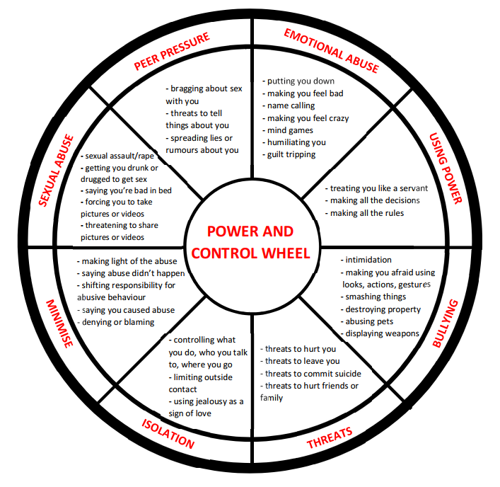
Domestic abuse dynamics and tactics

Slide 4
Lauren Laverne
“What I remember most about emotional abuse is that it’s like being put in a box. / How you end up in there is the biggest trick. / Maybe you think it’s a treasure box at first: you’re in there because you’re special.”/
“Soon the box starts to shrink. Every time you touch the edges there is an “argument”. / So, you try to make yourself fit. You curl up, become smaller, quieter, remove the ‘offensive’ parts of your personality. / You eliminate people and interests, change your behaviour. / But still the box gets smaller. You think it’s your fault.”

Slide 5
Herefordshire Services Services for all
Helpline
Free, confidential, non judgmental advice and support - Herefordshire 0800 783 1359
Men’s Domestic Abuse Helpline 0800 0149082
24hrs a day, 7 days a week, 365 days of the year
Listening support
One-to-one support and advocacy, risk assessing and safety planning
Referrals to safe accommodation, IDVA, legal advice, group support programmes, support for children
Recovery Pathway – group programmes for those who are still in, or who have left abusive relationships
Referral and signposting to other appropriate agencies
Email and chat line

Slide 6
Herefordshire Services Services for all
Safe Accommodation
Women’s Refuge – self contained flats with disability suite
Extended refuge – houses and flats in the community (protected characteristics, pets)
6 months tailored and intensive support
Children and Young People’s worker

Slide 7
Herefordshire Services Services for all
Independent Domestic Violence Advisors (IDVA)
High Risk domestic abuse cases – usually scoring over 14 on the DASH
Short term work to reduce risk
Works alongside the MARAC process
Hospital IDVA’s
Inclusion IDVA’s

Slide 8
Herefordshire Services Services for all
Children & Young People
Adult Community support
Trauma informed support for CYP. A strong focus on self-esteem, self-care and understanding healthy relationships.
Helping Hands 7-12 years
Recovery Toolkit 11-18 years
CRUSH 13-19 years
1-2-1 Support 5-18 years
Young Peoples IDVA’s 13+ years
DA prevention worker – for those displaying harmful behaviours
12 week group support programmes:
The Freedom Programme – perpetrator tactics
Nurture Programme – supporting children through domestic abuse
Power to change - repair and re-build of self-esteem and confidence
Recovery Toolkit - improving psychological well-being through developing positive lifestyle and coping strategies

Slide 9
Herefordshire Services Services for all
Support Services for men
Freephone men’s domestic abuse Helpline
Community Group Support
Safe accommodation
One to one support
https://youtu.be/BVTdbFXT4_M

Slide 10
Barriers to support
Rurality
https://www.ruralmedia.co.uk/TheWillows
Lack of services, isolation, awareness, community, poverty, traditional roles of men and women
Talk Community, The Hope Centre Bromyard, W.I.’s, Parish Clerks and village halls.
Gender – male, female, non binary, transgender
Age – those over 60 are much more likely to experience abuse from an adult family member or intimate partner than those under 60
https://youtu.be/JQtfUUpdB6k

Slide 11
Barriers to support
Ethnicity, Culture and religion – threats relating to immigration, language barrier, honour based violence
Sexual identity – LGBT+
Intimidation and threats of disclosure of sexual orientation and gender identity to family, friends, work colleagues, community
making a person feel guilty or ashamed of their sexual orientation and gender
Limiting or controlling access to LGBT+ spaces
Using immigration law to threaten a person with deportation to the country of origin, which might be unsafe due to anti-gay legislation (GALOP 2021)
Who am I anymore? https://youtu.be/j3zPW20ID8c

Slide 12
Changing the narrative
Why don’t they leave?
Fear, coercion, shame, protecting children, finances, low self esteem, don’t recognise the abuse, love for their perpetrator, lack of confidence in professionals, impact on work/education, social stigma, not wanting to leave their home and local support networks, poor mental health, physical disability……………
Why do they do that?
DRIVE
Men & Masculinities programme

Slide 13
www.westmerciawomensaid.org
Helpline 0800 7831359
Male Domestic Abuse Helpline 0800 014 9082
Thank you!

