Slide 1
Launch Youth Hub on the Safeguarding partnerships website
Kate Ross,
Website Development Coordinator, on behalf of Herefordshire Safeguarding Children Partnership
Notes:
Introduce Kate
Background to Youth Hub
Feedback from young people

Slide 2
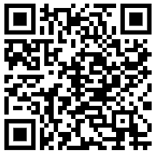
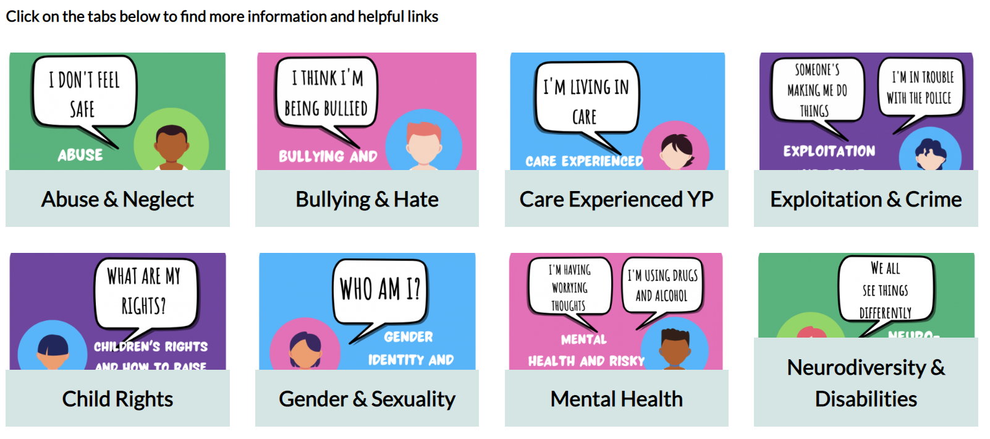
The ‘Youth Hub’ is for young people in Herefordshire, age 11+, who are worried about something and are looking for information, help and advice on topics that will help to keep them safe.
www.herefordshiresafeguardingboards.org.uk/youth-hub

Slide 3
Short Navigational Video
Herefordshire Safeguarding Partnership - Youth Hub Navigation - YouTube

Slide 4
Help share the site…
Bookmark the site & share with young people when needed
Print a pin-up postcard (or email us for copies – admin.sbu@herefordshire.gov.uk)
Link to it on your organisation’s website or staff resource pages
Post about it on social media

