Slide 1
Hate Crime
#No2Hate
Matt Cole - West Mercia Hate Crime Training & Engagement Officer
© Victim Support 2022

Slide 2
Who are we?
VS is the leading independent victims’ charity in England and Wales. Our purpose is to help and empower people affected by crime and traumatic incidents to move beyond crime and recover to the point where they feel they are back on track with their lives.
We are independent of the police and local authorities but work with them and the whole of the criminal justice system and other relevant bodies to improve services for victims and provide much needed support.
© Victim Support 2022

Slide 3
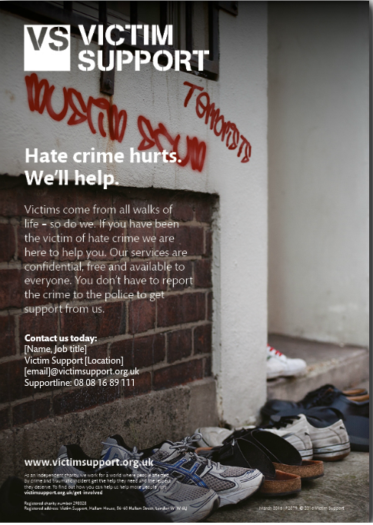
What We Do
Advocacy – Police and Housing
Reporting – 3rd Party Reports & anonymous reporting
Emotional Support – Face to Face and telephone
Confidence and resilience building – Beyond Crime workbooks
Restorative Justice
Personal Safety
CICA signposting
Practical Support
Community / Organisation Awareness
Live Chat
My Support Space
© Victim Support 2022

Slide 4
In West Mercia we provide support for Victims of:
ASB
CYP
Domestic abuse
Modern day slavery
Fraud
Hate crime
Homicide
Sexual violence
victimsupport.org.uk
Notes:
As part of our multi crime service and specialised projects
And in West Mercia we are also the commissioned service for Restorative Justice

Slide 5
….And Today We Look At
What is Hate Crime?
Who does it affect?
The impact of Hate Crime
Support
Reporting Hate Crime
© Victim Support 2022

Slide 6
The key priorities of our Hate Crime Service are:
Increase public awareness of and confidence in reporting hate-related crimes and incidents
Increase awareness of Restorative Justice as an avenue of redress for hate related incidents and how to refer to this approach

Slide 7
What is it?
?
What do we mean when we talk about Hate Crime?
© Victim Support 2022
Notes:
Ask for examples on what Hate Crime is to them – next slide is legal definition

Slide 8
Identity
© Victim Support 2022
Notes:
Identity: HC is an identity based crime. Identity is multi-layered and complex.

Slide 9
What do we mean when we talk about ‘Hate Crime’?
Any criminal offence or incident which is perceived by the victim or any other person, to be motivated by hostility or prejudice towards someone based on a personal characteristic.
© Victim Support 2022

Slide 10
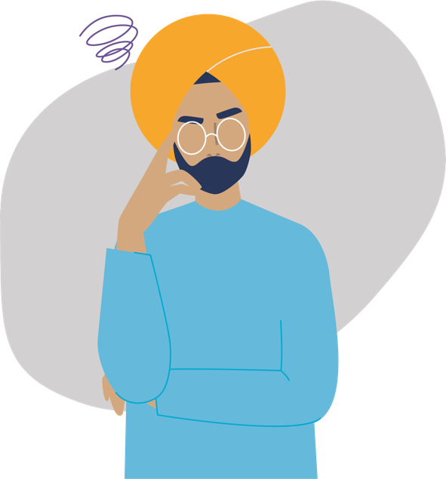
Protected Groups
What do we mean when we talk about ‘protected groups’ in Hate Crime?
Race
Religion & Faith
Sexual Orientation
Transgender
Disability
?
© Victim Support 2022
Notes:
Transgender: Gender identity is the gender that a person "identifies" with or feels themselves to be. While biological sex and gender identity are the same for most people, this is not the case for everyone

Slide 11
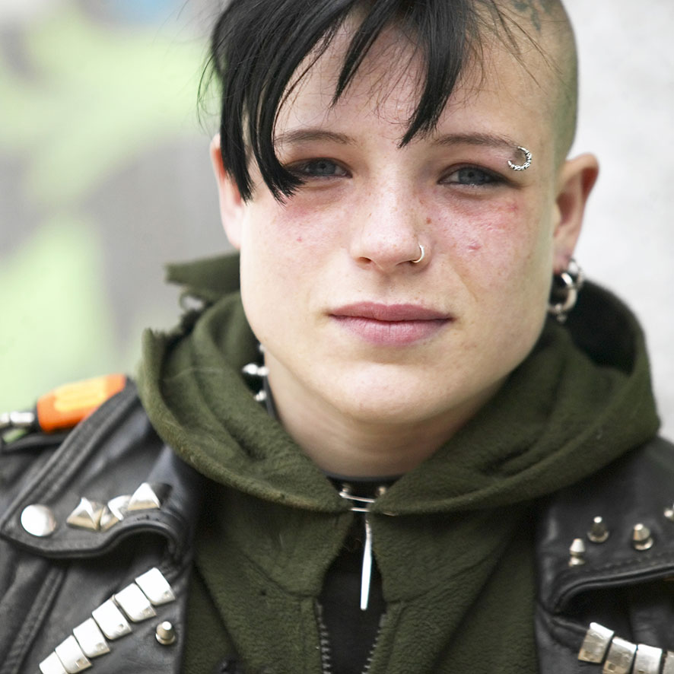
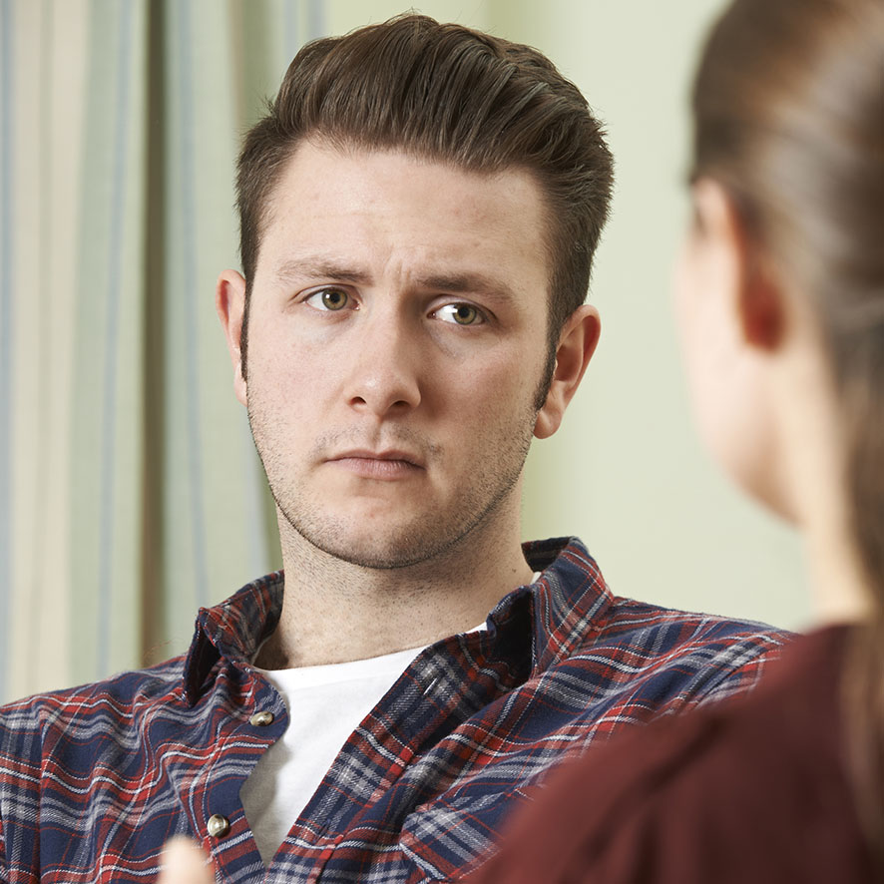
Intersectionality
“Many of our social justice problems like racism and sexism are often overlapping creating multiple levels of social injustice”
Kimberle Crenshaw
They may fall into two or more of the protected groups
People may experience ‘Double Discrimination’ or experience Hate aimed at more than one protected characteristic
For example, someone may experience a Hate Crime that is both transphobic and homophobic
© Victim Support 2022
Notes:
“The Term “Intersectionality” was coined by Lawyer Kimberle Crenshaw in 1989. Kimberle, upon reading of Emma Degraffenreid who took a business to court as she believed she was not hired because of her gender and race. The Judge dismissed the claim as the company did employ Women and Black people. However looking more closely, Black men were hired to work as warehouse operatives and white women as secretaries and administrators. There was no way to describe the “Double Discrimination” experienced by Degraffenreid before Kimberle Crenshaw outlined the meaning of intersectionality.
Slide 2
In terms of hate crime people may experience hate because of who they are and because they fall into more than one protected groups:
Examples:
Someone who is transgender and gay
Someone who’s faith is in Islam and lives with a disability
Someone who is Black and transgender
The impact for someone who experiences HC or HI is more profound because even more of their identity is ???? – want to say more on this as so but struggling with phrasing (It can be more profound because they may have lost some of their support due to their intersectionality. For example, my partner grew up in a Pentecostal church, his parents were heavily involved with all aspects but when he initially came out as gay he was rejected by his parents and the church resulting in losing support, a sense of belonging and facing outright discrimination from the church itself. Also may be important to note that the discrimination/hate quite often comes from people in the other protected group, e.g. somebody who is gay/bi and trans can often experience hate from LGB people – Hope this helps Claire)
Kimberle Crenshaws Ted Talk on intersectionality is a very useful resource to help understand how people who experience double discrimination are often not seen in society and therefore not protected appropriately”

Slide 12
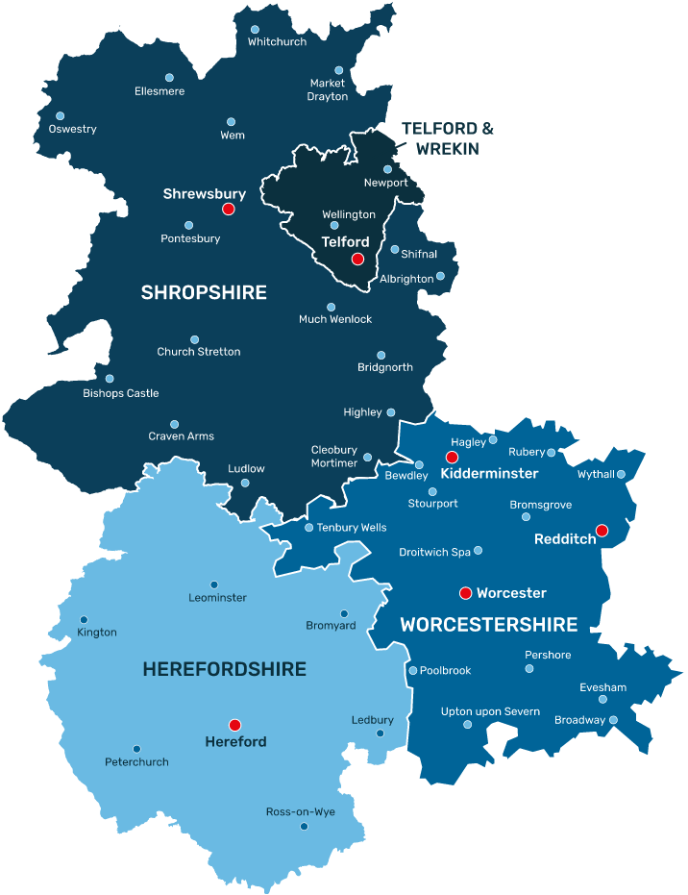
Hate in West Mercia
Hate Offences And Incidents Across West Mercia April 2022 – Feb 2023
 | YTM | YTM (Last Year) | % change
Hate Offences | 1800 | 1912 | -5.9%
Hate Incidents (Crimed) | 232 | 258 | -10.5%
“Hate Offences” relates to Hate Crimes – i.e. an actual crime, motivated by hatred for a protected characteristic.
Meanwhile, “Hate Incidents (Crimed)” relates to Hate Incidents – i.e. something that isn't quite a crime (doesn’t meet criminal threshold), and which the police normally wouldn’t record or deal with, but because it was motivated by hatred for a protected characteristic, we do record it, and where to, also do something about it (I.e. cautions etc)
+16%
© Victim Support 2022

Slide 13
The Landscape - Covid
At least a 27% increase in Hate Crimes towards East and South East Asian people from 2019 to 2020
Victim Support saw spike in referrals from victims of racial and homophobic hate crimes in England and Wales during the coronavirus pandemic.
Sexual orientation-related referrals more than doubled and race and nationality-related referrals increased by 64%.
© Victim Support 2022
Notes:
Home Office Data Slide
What victims tell us (about rise)
Rightwing presence in communities
WG commitment to tacking HC
End Violence and Racism Against ESEA Communities (EVR) are an intergenerational anti-racism campaign group they submitted a series of Freedom of Information requests to police forces across the UK about how many hate crimes take place against ESEA (East & South East Asian) people in the UK each year? They received data from 65% of police forces.
Real figures likely to be higher – not all police forces respinded, several forces did not provide data for 2018, data from 2021 is only provided by some institutions, and then only up until April, not all hate crimes against ESEA people will be reported to police, not all hate crimes against ESEA people will be recorded as such.
Info from Hate Crime Data — End Violence and Racism Against ESEA Communities (evresea.com)
Victim Support
Some families too scared to sit in their gardens during pandemic.
Intimidation from neighbours was a recurring theme, with people being verbally abused and coughed at.

Slide 14
Impact
?
What impact can Hate Crime have on people who experience it?
© Victim Support 2022

Slide 15
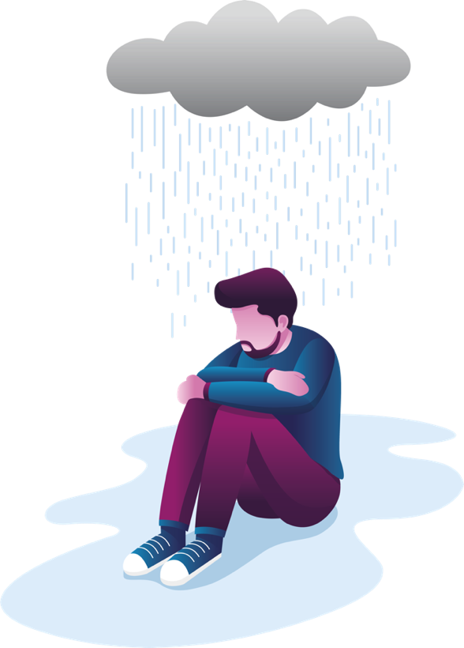
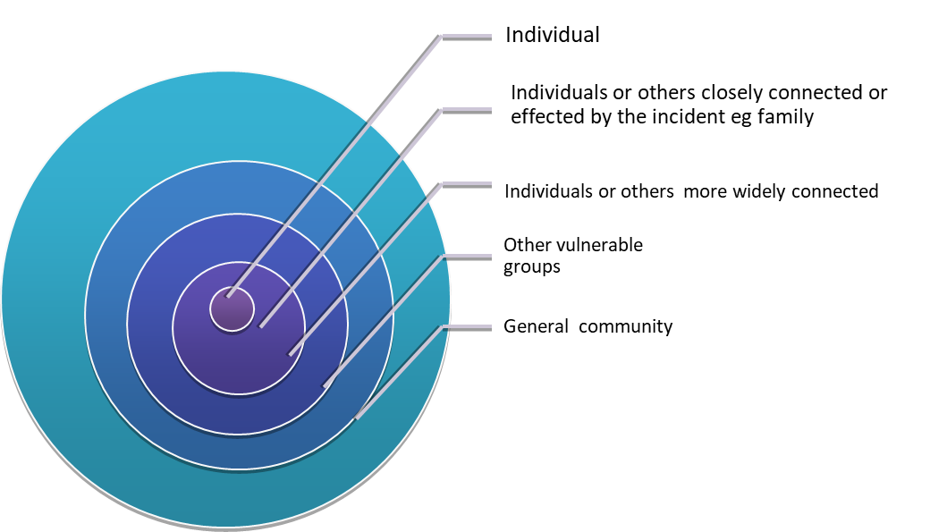
The Impact of Hate Crime
Emotional: Reduced self-esteem, Anger, Frustration
Behavioral: Isolation, Carrying an alarm, Forced to move, hypervigilant
Physical and Mental Health: Injury, Anxiety, Trauma
Financial: Repairs, Insurance, Home Security, Replacement items
© Victim Support 2022

Slide 16
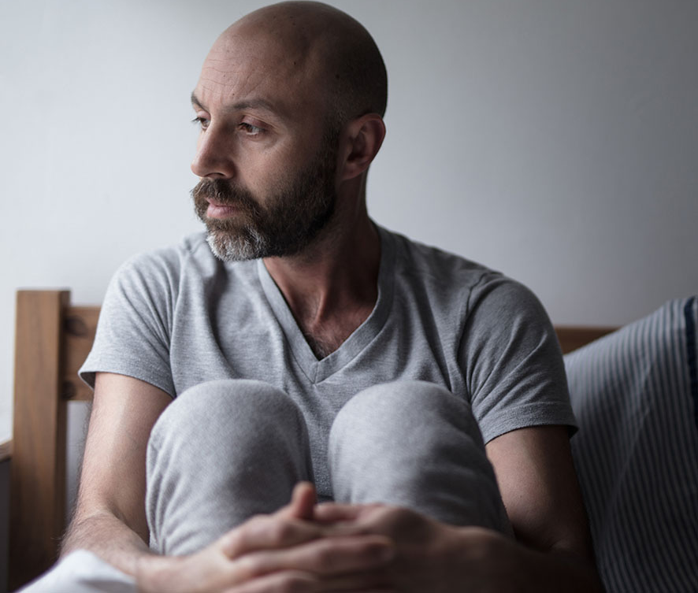
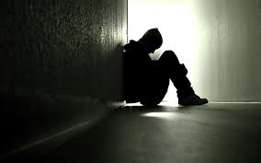
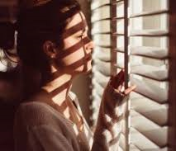
The Impact of Hate Crime – Hate Hurts More
Victims of hate crime are more likely to experience depression, post-traumatic stress disorder and/or anxiety
4x
Community impacts of hate crime –
University of Sussex
© Victim Support 2022
Notes:
Hate Crime is identity based crime – it targets key aspects of who we are. Identities are multi-layered and complex. The impacts of identity based crime/hate can in turn be multi-layered and complex.

Slide 17
What might I see that makes me ask questions?
Graffiti
Broken/Damaged property
Rubbish in the garden
Conversation – what are neighbours/neighbourhood like

Slide 18
I Think I’m A victim Of Hate Crime / Know Someone Who is, Who Can I Tell?
Report to the Police 101 if the incident has already happened, 999 if you / they are in danger
Reporting Centres - TBC
True Vision – Online reporting
Speak to Victim Support for Emotional and Practical help

Slide 19
How Do I Report Hate Crime?

Slide 20
Thank you
© Victim Support 2022

