Slide 1
M.E.A.M
Making Every Adult Matter
Hayley Crane – Strategic Housing Manager
Bob Barnett – Housing Strategy Officer
Community Wellbeing Directorate, Herefordshire Council
Notes:
Introductions and thanks for invite.
MEAM – Making Every Adult Matter.
Basic Info:
MEAM is a coalition of national charities, Mind, Homeless Link and Clinks, with associate member Collective Voice.
We includes collaboration with people with lived and living experience of the system.
Mind – biggest national mental health charity, operating a federated model of 125 local minds.
Homeless Link – umbrella body for the homelessness sector.
Clinks – umbrella body for voluntary sector criminal justice organisations.
Collective Voice- Drugscope were a founding partner of MEAM and we recognise the importance of the substance misuse sector being part of our coalition. Collective Voice are an associate member as they are a relatively new organisation, working through the process of becoming a member.
MEAM came together in 2008 because of a recognition that services were not set up to support people experiencing multiple problems at once.
As a result people experiencing multiple problems had poor experiences of services, did not have their needs met, and as a result this group were labelled as “chaotic”, “complex” or “not engaging”
Additional Contextual Info:
Mind- Biggest national mental health charity, federated model of around 125 local Minds delivering mental health services across the country, extremely varied in terms of size, approach, services and reach. National organisation that works on campaigning, flagship programmes, legal team, biggest producer of mental health information resources. Vision: “we won't give up until everyone experiencing a mental health problem gets support and respect.” https://www.mind.org.uk/
Clinks – Clinks supports, promotes and represents the voluntary sector working with people in the criminal justice system and their families. Our vision is of a vibrant, independent and resilient voluntary sector that enables people to transform their lives. https://www.clinks.org/
Homeless Link - We want a country free from homelessness, where everyone has a place to call home and the support they need to keep it. https://www.homeless.org.uk/
Collective Voice- Collective Voice is the national alliance of drug and alcohol treatment charities.
It was created in 2015 by voluntary sector organisations coming together to ensure the voice of the the drug and alcohol treatment sector, and the people who use its services, was heard in policy and political discussions. https://www.collectivevoice.org.uk/who-we-are/

Slide 2
M.E.A.M
What is M.E.A.M.?
Who are they?
What do they do?
More information - Home - MEAM
Notes:
Brief history of MEAM
When MEAM was first formed there was a cross sector conversation between a range of national charities from within homelessness, mental health, substance misuse and criminal justice.
The 4 charities (included Drugscope at the time) emerged as those whose network had a huge reach and could move the work forward.
The work started with about a year’s worth of policy work ahead of the 2010/2011 elections, producing a manifesto on multiple needs: http://www.meam.org.uk/wp-content/uploads/2018/09/MEAM-asks-Mar15.pdf
Not longer after this an initial EOI process was held, and areas were given a small grant to kick start their work the pilot areas were: Cambridgeshire, Somerset and Derby. At this stage the MEAM Approach wheel consisted of: coordination, flexibility, consistency and measurement. The rest of the approach was developed with learning from the pilot areas.
The network has continued to expand.
In 2017 we received a major investment from the Big Lottery Community Fund, to expand the network, enhance the support offer from MEAM and embark on a large scale evaluation of the approach.
No funding with it though.
Does have project management / support development though – Greg Headley.
Does help areas secure funding wider though once an operational member of the network.
Multiple Disadvantage is defined as: -
Homelessness
Substance misuse;
Contact with Criminal Justice System; &
Mental ill Health
The combination of any or all of these mean that people find it difficult to engage with support services in any meaningful way. In 2015 ,the Lankelly Chase Organisation identified, in their paper titled “Hard Edges: Mapping Severe and Multiple Disadvantage in England”, that 58000 people were affected by the triple impact of Homelessness, Substance misuse and interaction with CJS. About 161,000 were affected by any two of them. (Hard-Edges-Mapping-SMD-2015.pdf (lankellychase.org.uk)) Just over 586,000 in the whole cohort assessed though.
MEAM was a network of 32 LA’s areas across England who had committed to adopting the MEAM approach to working.
In June 2022, the network was opened up to allow ten new areas to apply to join the wider network. Herefordshire applied and were successful at interview. We joined the network in September 2022.
What do MEAM do – well they focus upon seven key principles of multi agency and cross sector working to put the individual at the heart of any services or offer of services.
Our Vision:
In every local area people experiencing multiple disadvantage are:
Supported by effective, coordinated services
Empowered to tackle their problems, reach their full potential and contribute to their communities

Slide 3
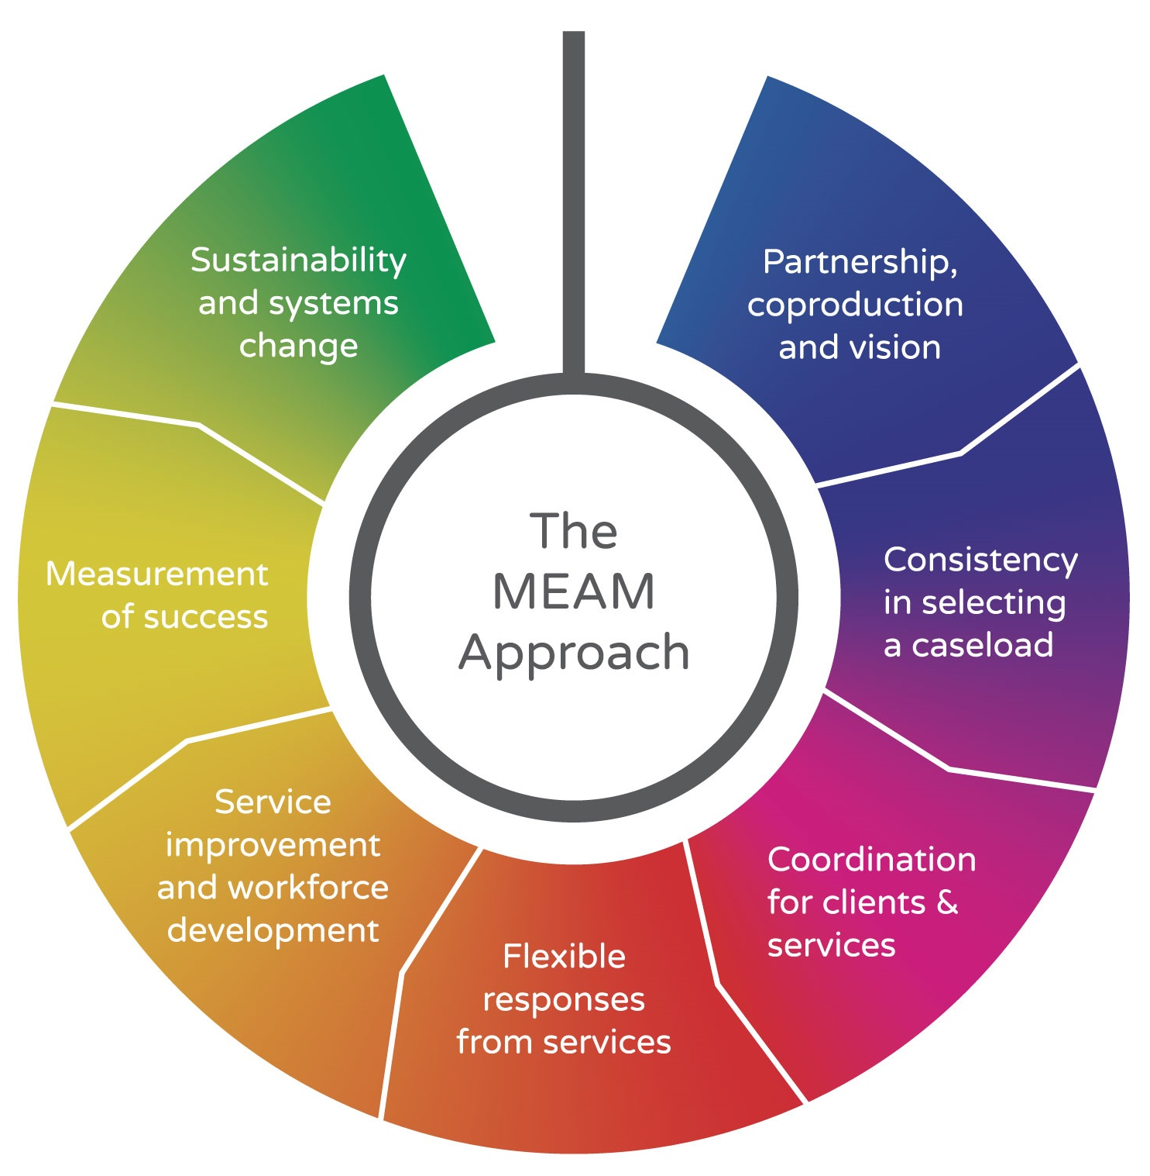
Not just adding new services to existing systems
Ground work established
Shared vision
Leverage
Clients identified
Focus on additional cohorts
Robust evaluation of both approaches
Partnership approach to make wrap around support work
Coordination/ Navigation model
Solution to some local system issues, for some clients
Introduction to this way of working
Notes:
Why Seven Steps?
All local areas using the MEAM approach have a multi-agency partnership in place to guide the work, with representatives from statutory and voluntary services
That partnership should be cross-sector and includes providers, commissioners, people with lived experience, and key decision makers who together are committed to leading the work
The aim is to create an intervention/response to multiple disadvantage for the ‘area as a whole’
Some areas have LA leading the partnerships, others VCS, Police or are jointly led by all or a few of the partners involved , such as Public health, Homelessness, Community Safety, Adults Social Care etc.
Why - Statutory agencies and the CVFS very rarely coordinated / cooperate in a broad enough way to have a meaningful impact upon people.
By adopting the MEAM approach and specifically the seven steps – multiple agencies and groups can develop cohesive approaches to working collaboratively in ways that put the individual or ‘service user’ at the centre of the work being done around them, for them and with them.
Herefordshire was successful in joining the network because we demonstrated our embryonic work that is ongoing through our Project BRAVE approach, and builds upon out Trauma Informed Approaches to working with people with multiple disadvantages training.
WHY DO IT DIFFERENTLY?
Accessing services individually is difficult enough when you are not having to cope with some of the issues mentioned earlier. Trying to do so when you are makes it almost impossible to see a way how too, and therefore people don’t. They wait until being at crisis point and then access things via emergency provision routes 0 Ambulance, A&E, Housing Support, Social Care and Police for advice re neighbour issues etc.
Accessing at crisis point costs about FOUR times as much as through early prevention routes – In England the 58,000 individual's referred to above that’s an average of £1.5 billion PA.

Slide 4
M.E.A.M in Herefordshire
Herefordshire Model
Our Approach – Project BRAVE (Building Resilience Against Endemic Vulnerabilities)
Our Vision for the future
Notes:
We have a number of multi agency approaches in Herefordshire – MATAC. MARAC, MASH to name a few. BUT this may be controversial – none of our pre-CV-19 structures actually fully coordinated services and put individuals at the centre of what we collectively did.
With the development of BRAVE – which took national and international best practice in approaches to addressing rough sleeping and complex needs to develop an integrated / cross sector approach to working with and for people affected by multiple disadvantage.
Our internal CBA work showed that a person with multiple complex needs accessing services via emergency routes, cost between £30,000 and £45,000 PA locally. A person with a single support need costs £5,000 PA to meet that need. (on average)
BRAVE and BTC were created to ensure that as far as possible resources were targeted to meet individuals needs in a coordinated way and reduce reliance upon accessing resources via emergency routes.
Our Vision – I to go on the offensive and move upstream of the ‘crisis’ point to try and identify and work with individuals sooner to prevent or mitigate the crisis occurring at all.
Better for individuals, their families and of course the public purse.
Commitment required from areas
Buy-in from senior reps across the system
Permission from decision makers for frontline staff to work differently
A clear loop of communication between individuals being supported, operational practitioners and strategic partners so that systems issues can be addressed
A commitment to sharing power and influence with people with lived experience of multiple disadvantage
Resource for operational coordination and strategic focus
A commitment to participate in the national evaluation and share the local learning
Key reading – MEAM’s report on key features of good partnership working ((click here)

Slide 5
M.E.A.M in Herefordshire
QUESTIONS?
Contacts – Hayley Crane – hayley.crane@herefordshire.gov.uk
Bob Barnett – robert.barnett@herefordshire.gov.uk

