Slide 1
Welcome The briefing will start shortly.
Please stay on mute unless speaking, to reduce background noise.
The briefing will be recorded, for admin purposes.
Our principles:
Children are at the heart of what we do, and we will learn from the actions we take.
We will make a difference to the lives of children and young people.
We will focus on the difference our partnership makes to the lives of children & young people.
We will ensure that children are at the heart of our discussions and the actions we take.
We will share information and work together with openness, respect, trust, and confidence.
We will challenge each other when this is needed and will welcome challenge in return, knowing this helps keep our system safe.

Slide 2
Welcome and opening remarks
Darryl Freeman
Chair, Herefordshire Safeguarding Children Partnership
Corporate Director for Children and Young People (Herefordshire Council)

Slide 3
Programme
Introducing our new Independent Scrutineer
Headlines – Inspection of Local Authority Children’s Services and the SEND Peer Review
Launch of our Neglect Strategy
Break
Group exercise- if we started with a blank sheet, what would the partnership look like?

Slide 4
Kevin Crompton
Independent Scrutineer

Slide 5
Inspection of Children’s Services
& SEND Peer Review
It’s a reflection on each of us…
HSCP Summit
31 October 2022

Slide 6
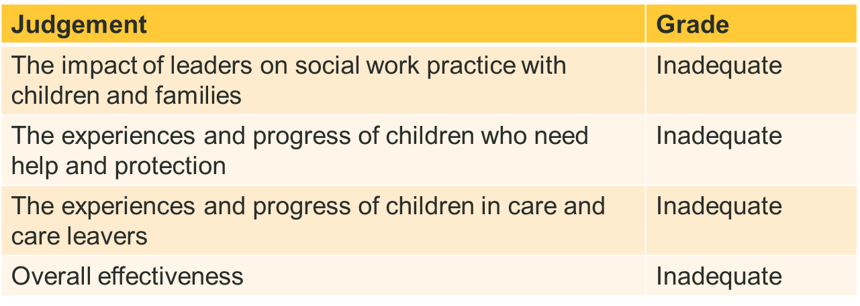
Inspection of Local Authority Children’s Services (ILACS)
Herefordshire children’s services are inadequate

Slide 7
Headlines
Children and young people in Herefordshire are not protected from harm.
Fundamental areas of social work practice are weak.
Assessments across the service are poor.
Plans do not ensure children are safer or have their needs met…
Drift and delays are endemic
The quality and impact of social work practice has significantly deteriorated since the last judgement inspection in June 2018.
Minimal improvements have made little difference to children’s experiences.
A historical lack of stable and capable senior management…

Slide 8
The experiences and progress of children who need help and protection: inadequate
There are widespread and serious failures which leave children harmed or at risk of harm.
Too many children do not have a consistent social worker to rely on.
Some children do not receive the right help at the right time.
Action to protect children is not taken soon enough.
Too many strategy meetings are delayed…
Most assessments, including child protection enquiries, are poor.
There is significant variability in social work practice across and within teams for children who need help and protection.
Most plans and planning are weak and do not ensure that children are sufficiently protected and that their lives improve.

Slide 9
Most children are seen regularly…
Skilled workers in the edge of care home team (ECHo) provide effective support to prevent family breakdown and provide help for carers.
When children receive support from the exploitation team, the work is effective.
Leaders have a clear oversight of children missing education and those electively home educated.

Slide 10
The experiences and progress of children in care and care leavers: inadequate
There are widespread and serious failures for children in care and care leavers in Herefordshire.
Too many children experience unnecessary delays in achieving permanence…
Assessments are mostly weak and do not identify children’s needs.
The local authority’s offer to care leavers is weak.
Young people have a lack of sufficient accommodation choice

Slide 11
The council’s permanence hub team has significant experience in the field of adoption and a good understanding of the adoption process… timescales for children achieving permanence and placement stability are good…
The virtual school is ambitious in ensuring that most children and young people in the care system make good educational progress…

Slide 12
The impact of leaders on social work practice with children and families: inadequate
The quality and impact of social work practice has significantly deteriorated since the last judgement inspection in June 2018.
Leaders and managers fail to safeguard and protect children in Herefordshire.
The pace of improvement is too slow.
Recently, there have been some small areas of progress from a significantly low base. Work is focused on building some of the infrastructures and systems to enable improvement.
Relationships with partner agencies are underdeveloped.

Slide 13
A permanent leadership team is now secured…
Recently, there have been some small areas of progress from a significantly low base.
Work is focussed on building some of the infrastructures and systems to enable improvement.
Although improvement plans have been refreshed, governance is clearer and work streams are recently established, many plans are still in development and it is too soon to assess their impact.

Slide 14
The Partnership
Inspectors concluded that there were under-developed partnerships, due in part to the churn of senior leaders and ineffective multi-agency arrangements.
Multi-agency governance arrangements are weak.
Operationally, agencies are not working together effectively.
There is much to do to ensure a collective responsibility across the partnership for the improvement of services to children and families.
This is our challenge….

Slide 15
What have we already done?
Strengthened the MASH
Reviewed all cases raised by inspectors
Reviewed all pre-proceedings cases
Increased the pace of improvements already planned (such as the revised pre-birth multi-agency panel).
New Need to Know (escalation) process and other practice guidance.
Started work on our Ofsted response plan (has to be submitted by 20 December)
A clear corporate commitment to increased retention and recruitment activity.

Slide 16
Responding to the report…
The service has to prepare and submit an action plan in response to the findings of the inspection report.
The action plan must be submitted by 20 December 2022.
Cabinet will sign off on the report before submission.
It should have input from children and families, our workforce, multi-agency partners, and from Members.
Engagement events have been planned and details circulated.
An online survey is also open.

Slide 17
The role of the Commissioner
Eleanor Brazil
Appointed by the Department for Education
Reports to the Secretary of State (at the time!)
Question: Should children’s services remain with Herefordshire Council? If yes – what support is required. If no – what alternative?

Slide 18
Questions / comment…

Slide 19
SEND Peer Review
Key lines of enquiry
Are children and young people’s needs identified accurately and assessed in a timely and effective way?
Are children, young people and their families appropriately and consistently supported and enabled participate in decision-making about their individual plans and support?
Do children and young people receive the right help at the right time
Are children and young people well prepared for their next steps, and achieve strong outcomes?

Slide 20
Headlines
Whilst there were some areas of good practice and evidence of positive impact for families, significant areas for development were identified, including:
A lack of a local partnership strategy
Health differences
Too many individual organisation strategies without plans, too many plans without strategies.
A lack of multi-agency data, and audit to demonstrate impact.

Slide 21
Recommendations
Review effectiveness of resources, service delivery and systems to meet the child’s needs and potential and the requirements of the SEND Green Paper
Establish the partnership governance and scrutiny arrangements at pace
Produce a multi-agency strategy with short, medium and long-term priorities
Develop a robust quality assurance framework for the local area with an immediate focus on all children with an EHCP open to Social Care and others with particular vulnerabilities

Slide 22
Neglect Strategy
Rebecca Haywood-Tibbetts
Deputy Designated Nurse (Safeguarding)
Chair of the HSCP Neglect sub-group

Slide 23
Break
Back in 10 minutes…
We’ll finish promptly at 12:30

Slide 24
Group exercise (breakout rooms)
Herefordshire partnerships are under-developed; the early help offer is limited; and agencies are not working together effectively… (Ofsted)

Slide 25
In your breakout rooms…
Imagine “Starting with a blank sheet…”
How would we want the partnership to work?
How would we know that it was effective?
What individual actions are we going to take, from today, to make it happen?
Each group to feedback 1 or 2 key points discussed.
Please share more general notes with the business unit after the session.

Slide 26
Feedback session
Kevin Crompton
Independent Scrutineer

Slide 27
Closing remarks and online evaluation
Darryl Freeman
Chair, Herefordshire Safeguarding Children Partnership

